Slide 1
Sprint #4
By Team [Hip, Hip]: Jack, Alea, and Elizabeth

Slide 2
Overview
DataGridView functionality where needed
Admin claim form
Fixed “confirm” functionality & unhandled exceptions
Message feature implementation
Allow managers to do their job
Overall functionality cleanup
Exit pages with options, etc.
Show/hide password added
Keeping design consistent
We will be talking about…

Slide 3
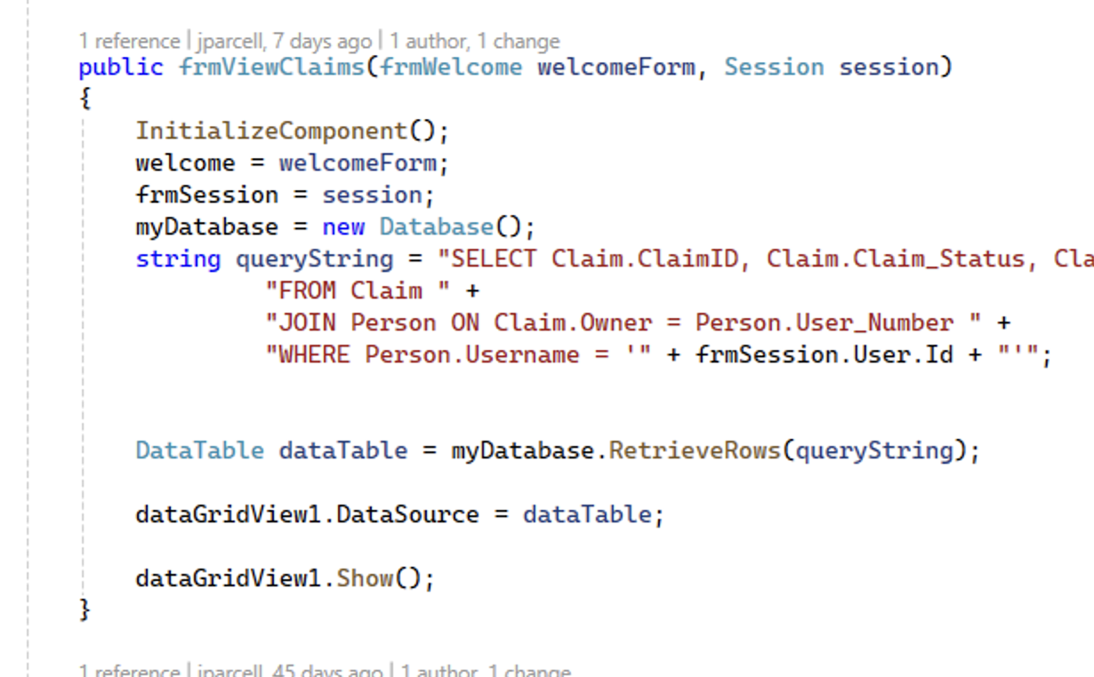
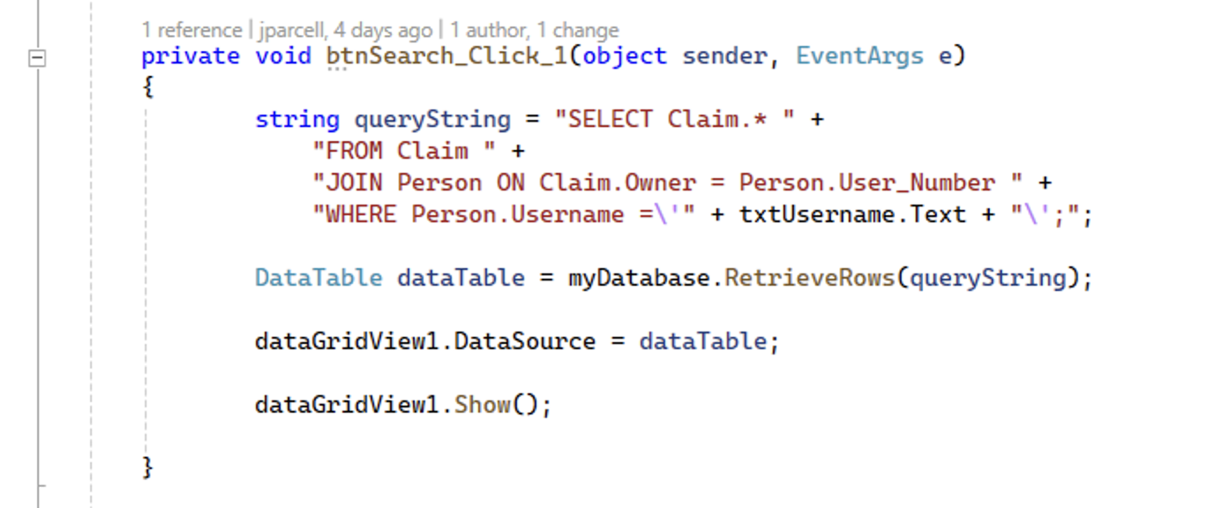
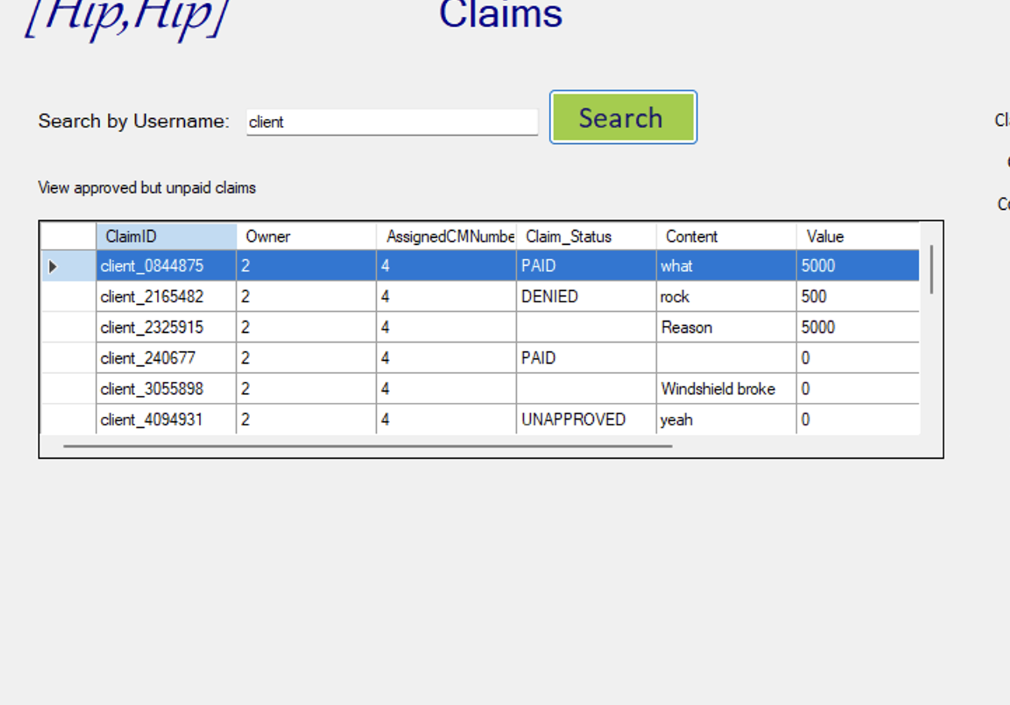
Loading Data Grid View

Slide 4
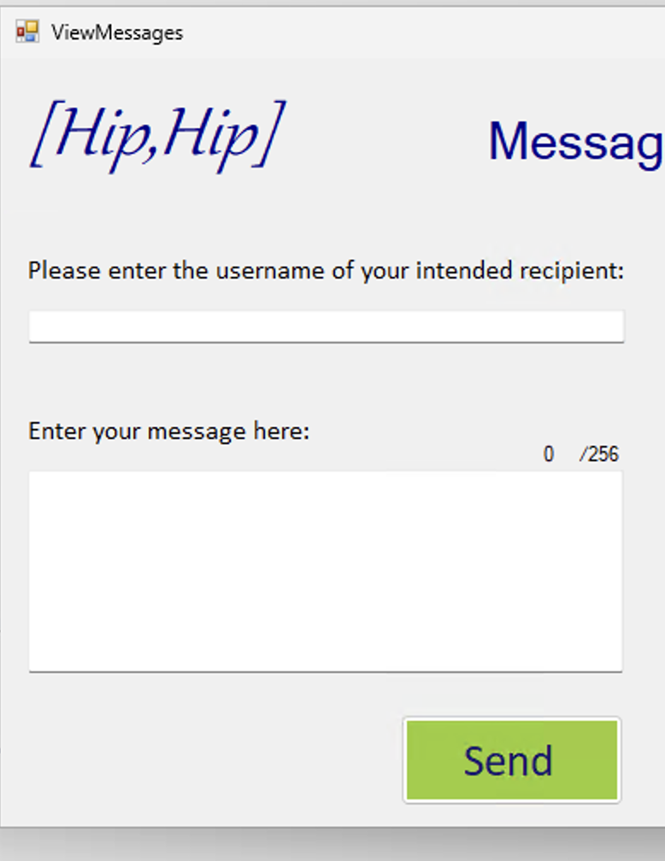
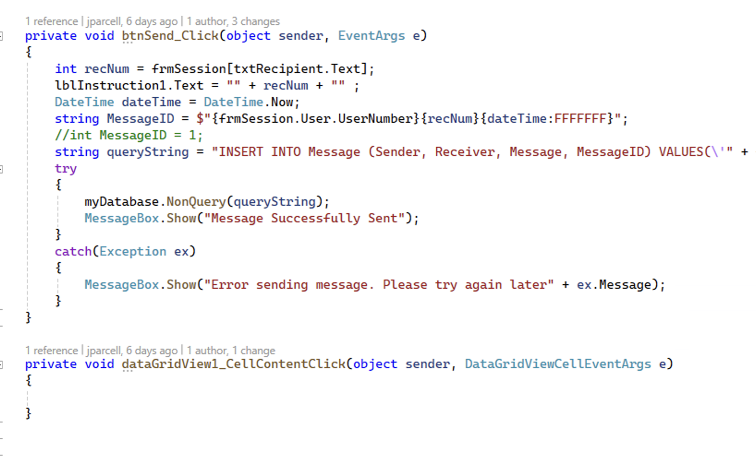
Sending a Message

Slide 5
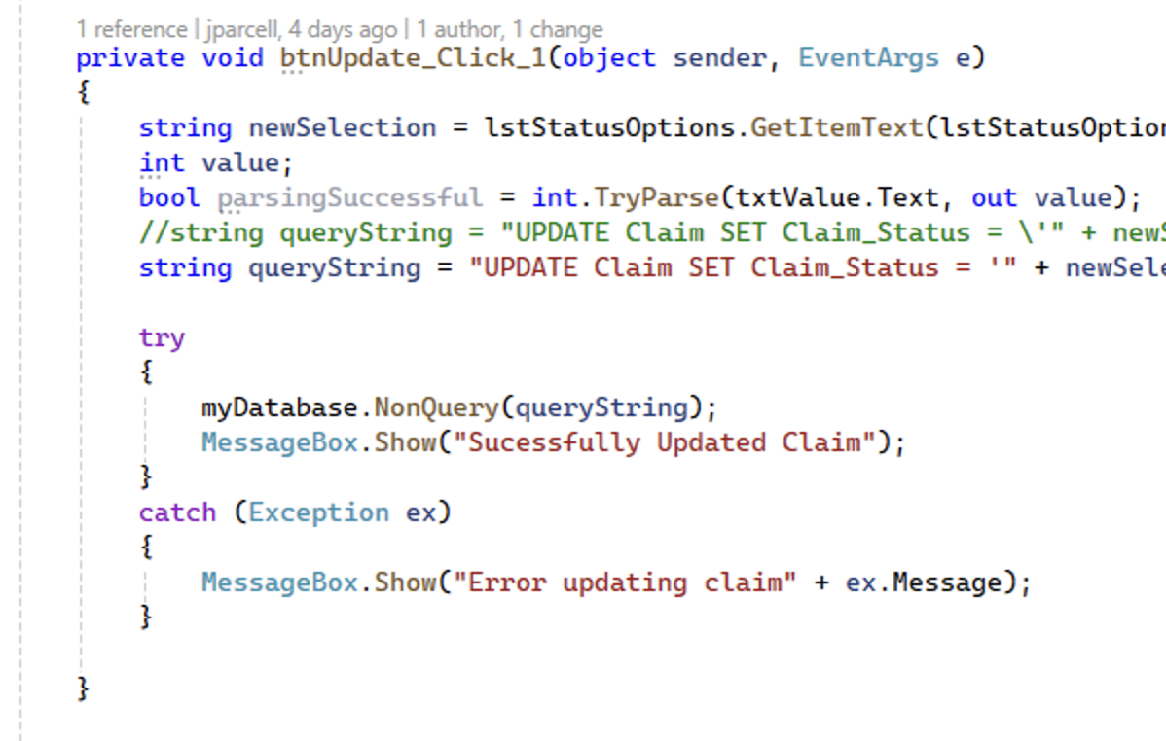
Updating a Claim

Slide 6
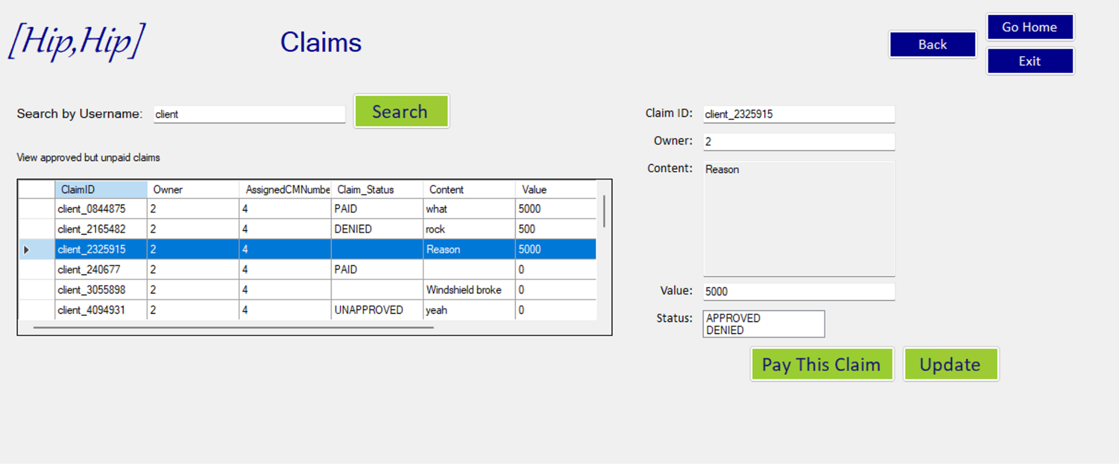

Slide 7
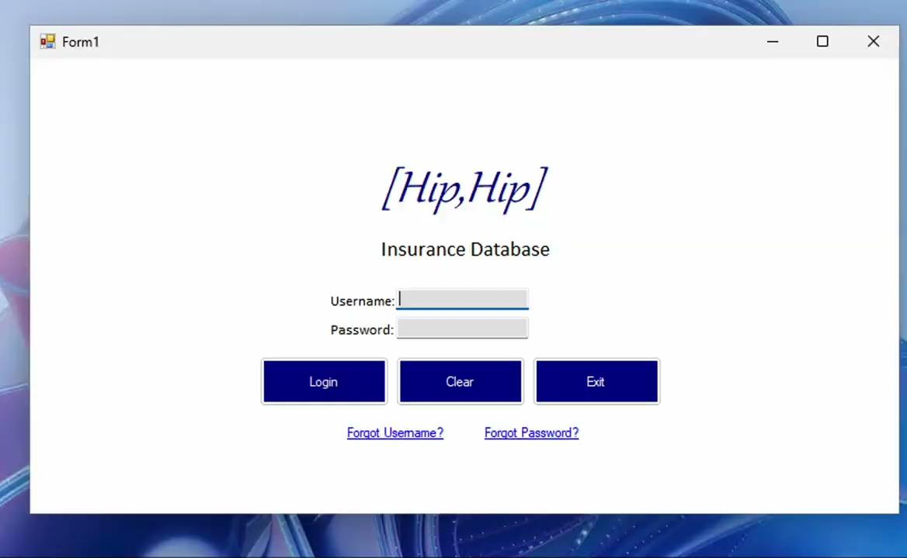
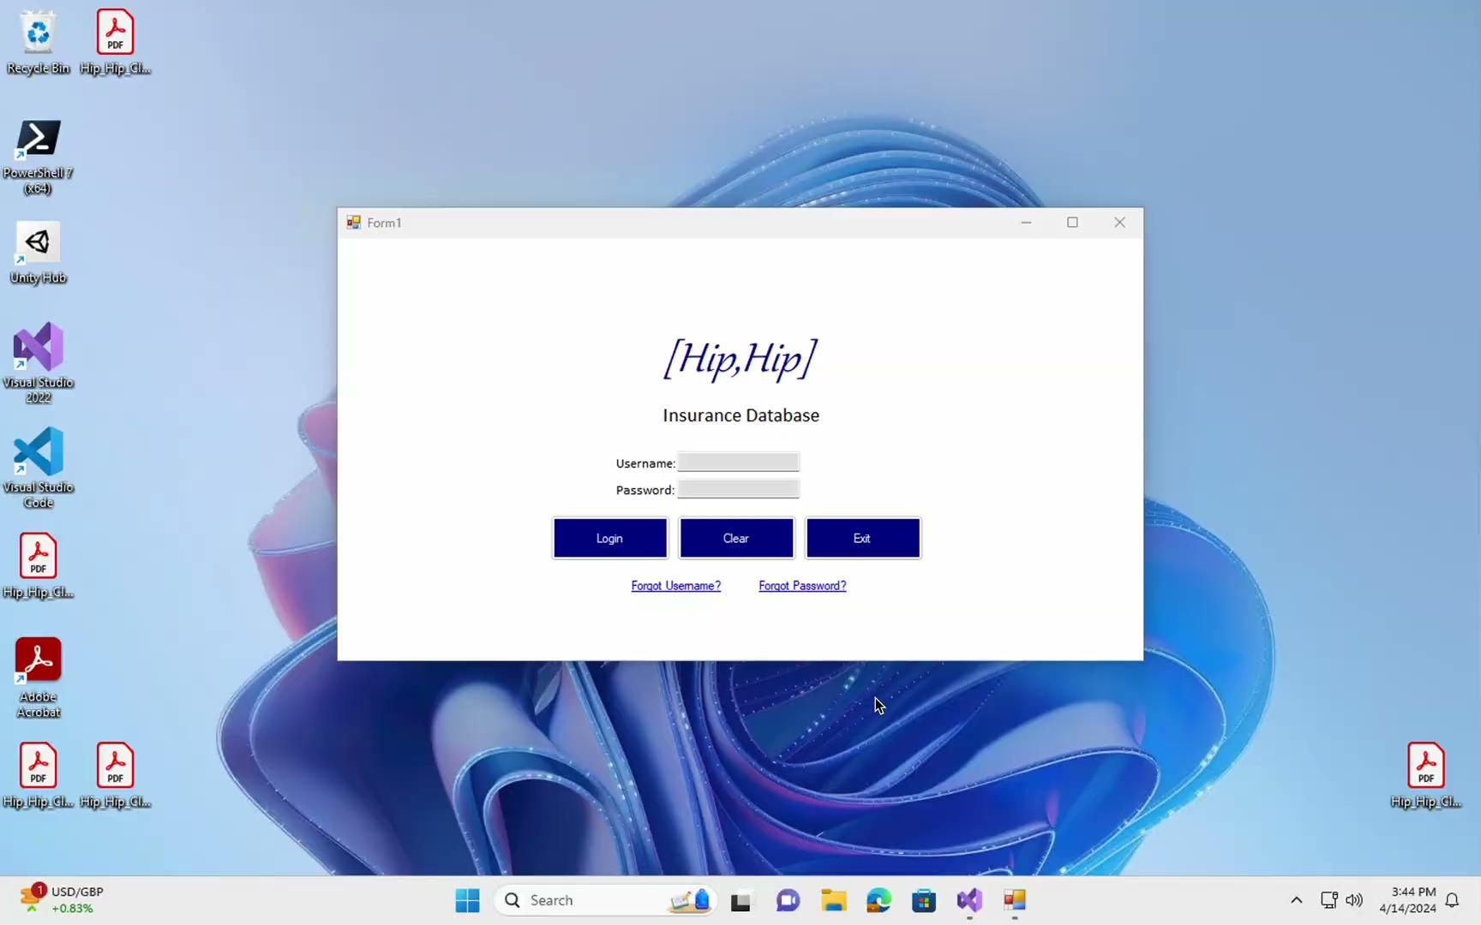
…Demo

Slide 8
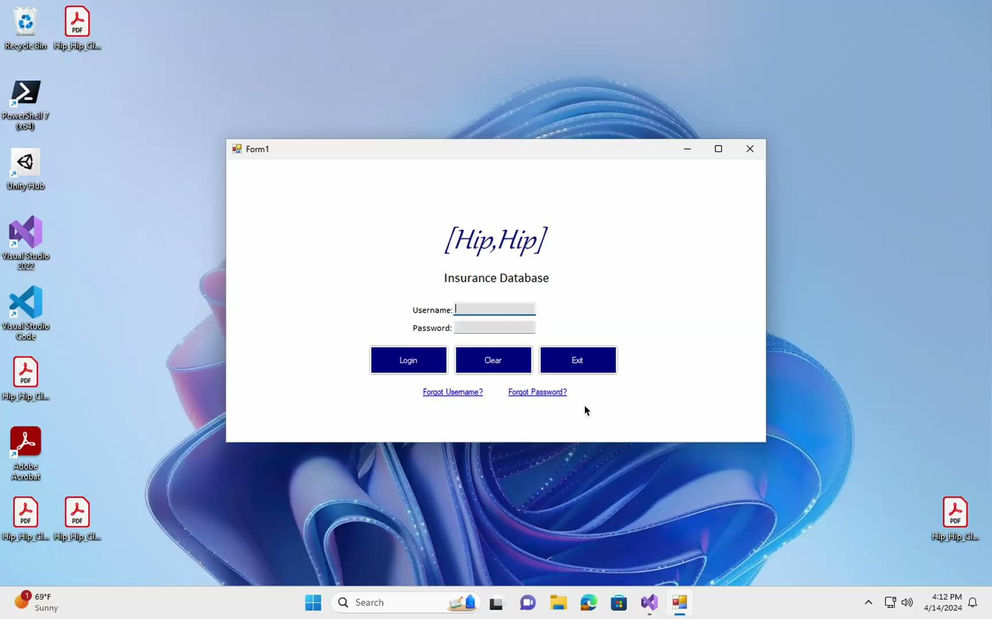
…Demo

Slide 9
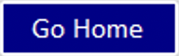


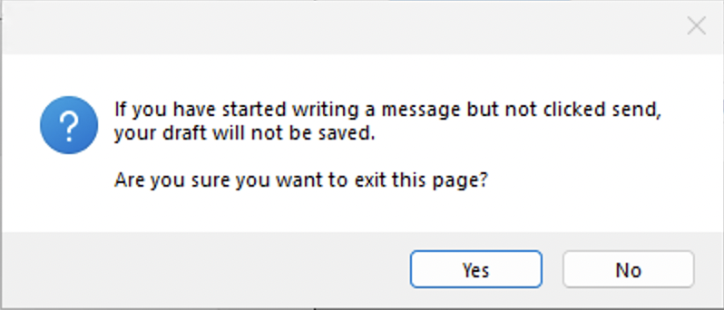
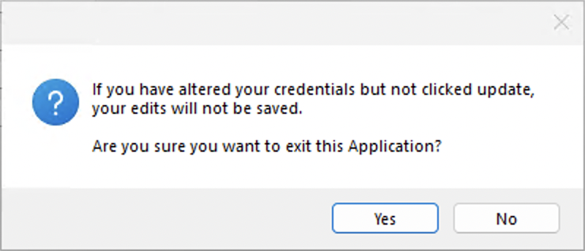
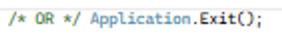
Yes/No Pop-Up

Slide 10

Show/Hide Password Demo

Slide 11
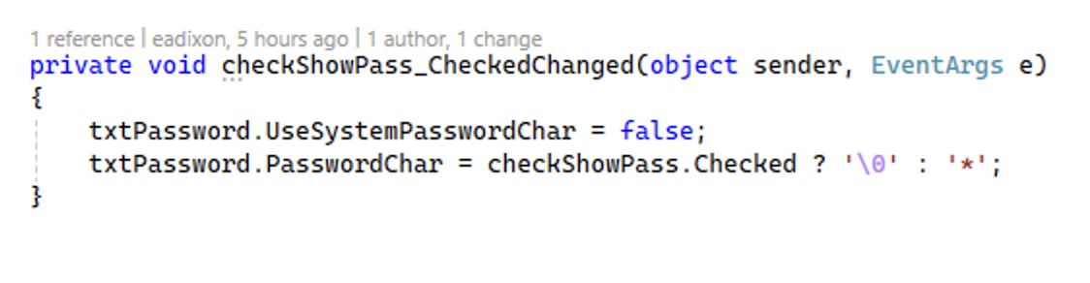
Design Consistencies
Behavior
Made sure data grids were read only
Empty text box fields when done
In show password, messages, etc.
Consistent design when new features added
Use the x-y location/sizing coordinates in properties
Checking colors/font

Slide 12
Challenges
Messed up a push and had to remake a form
PDF issues
Two people
Testing

Slide 13
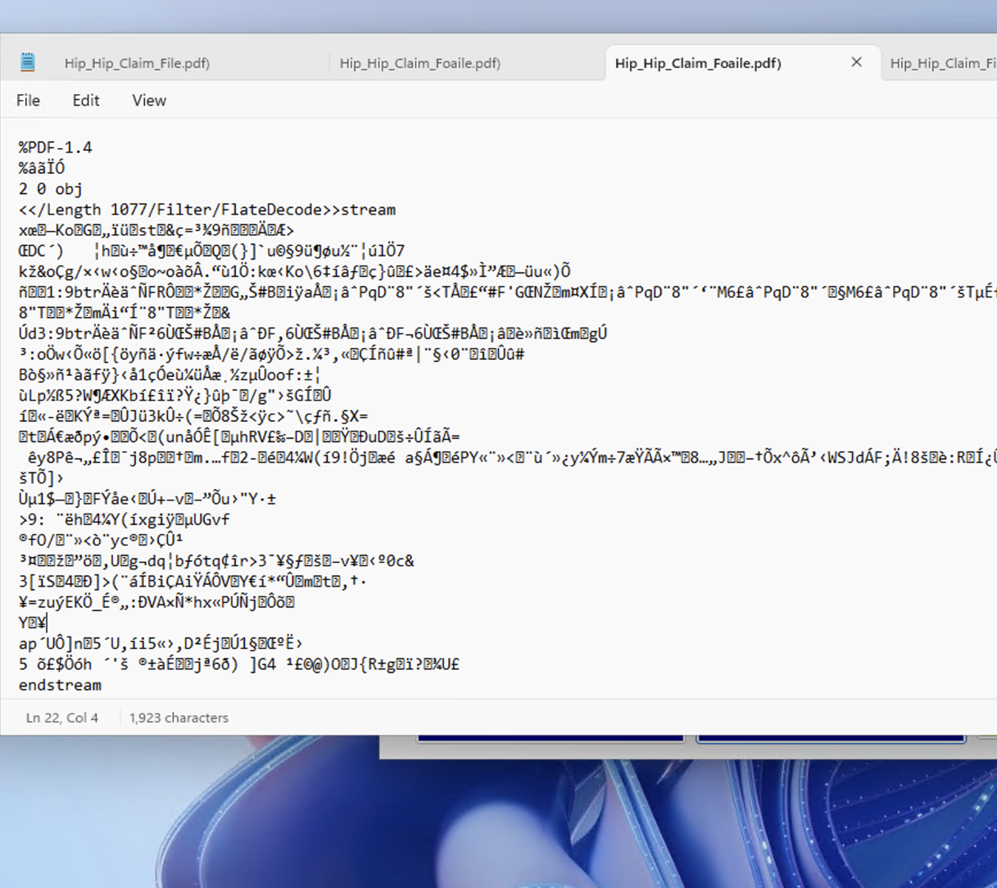
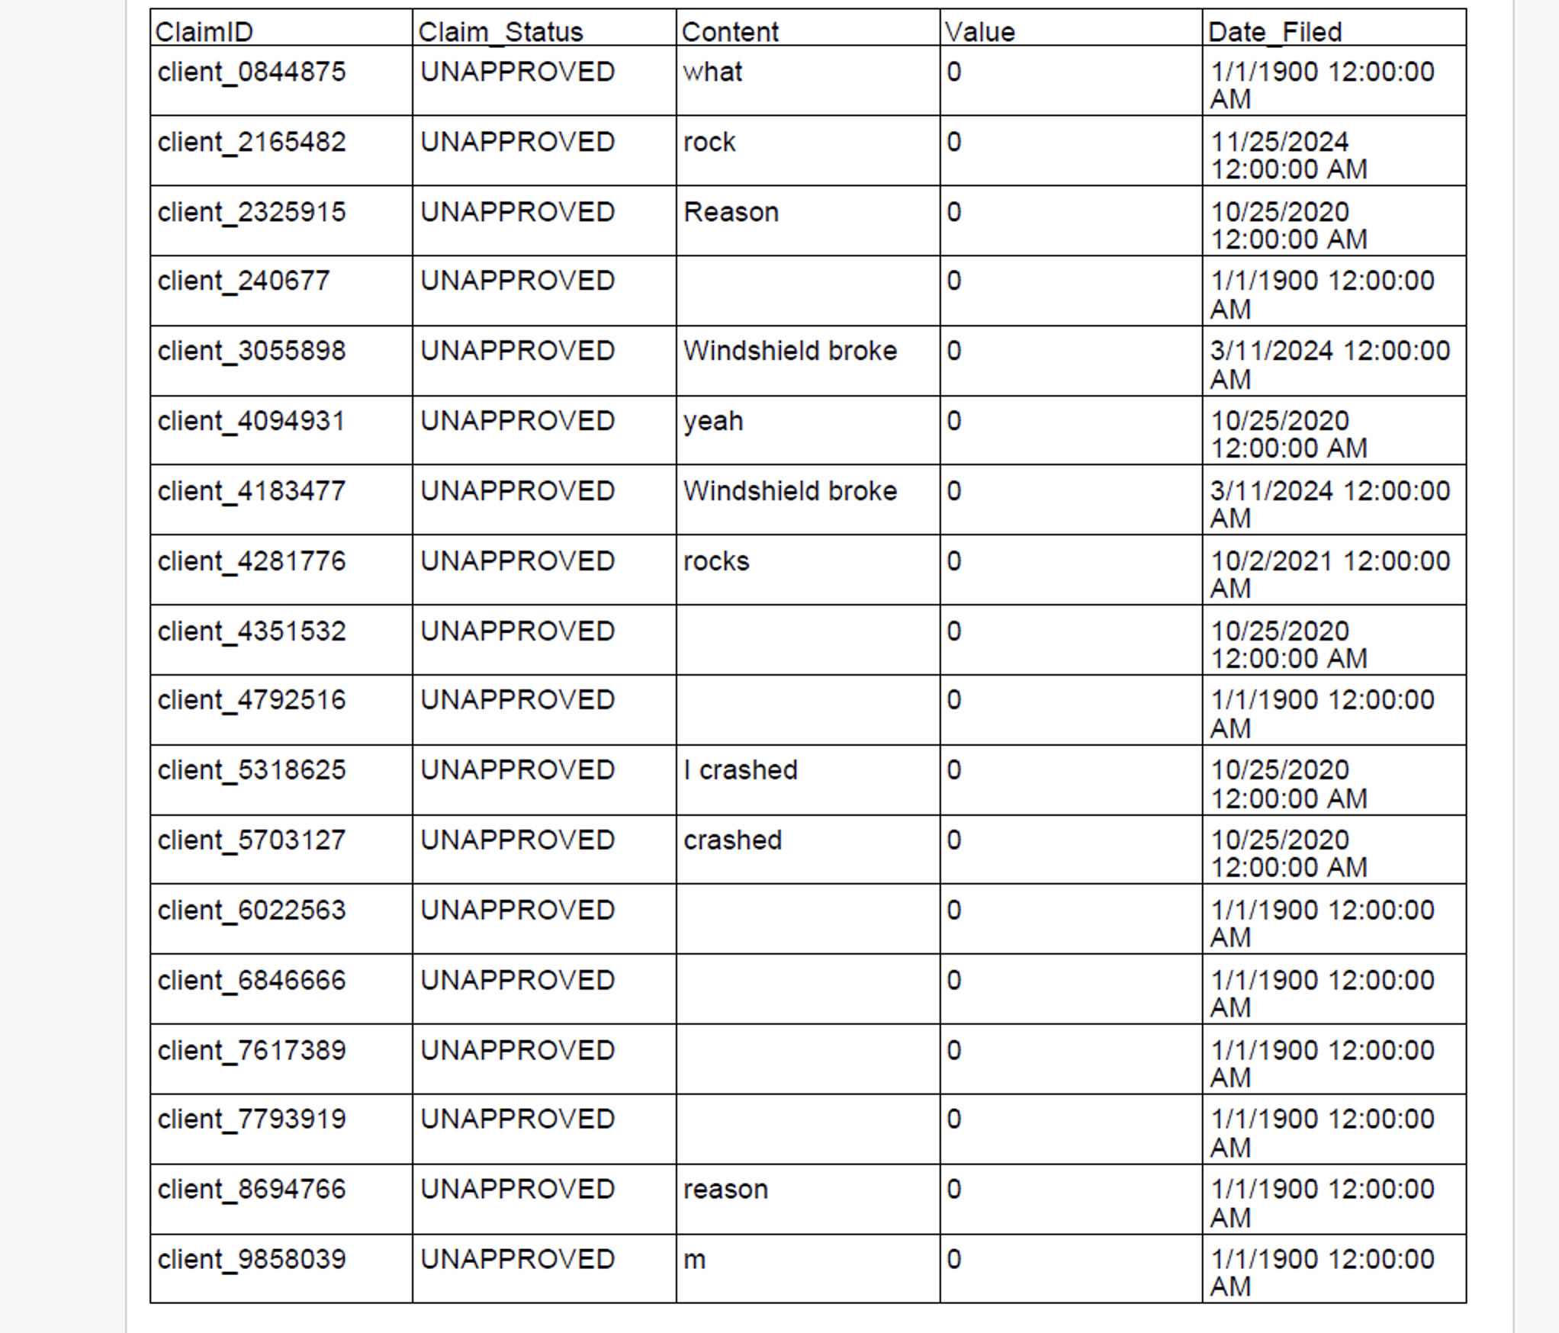
PDF issue

Slide 14
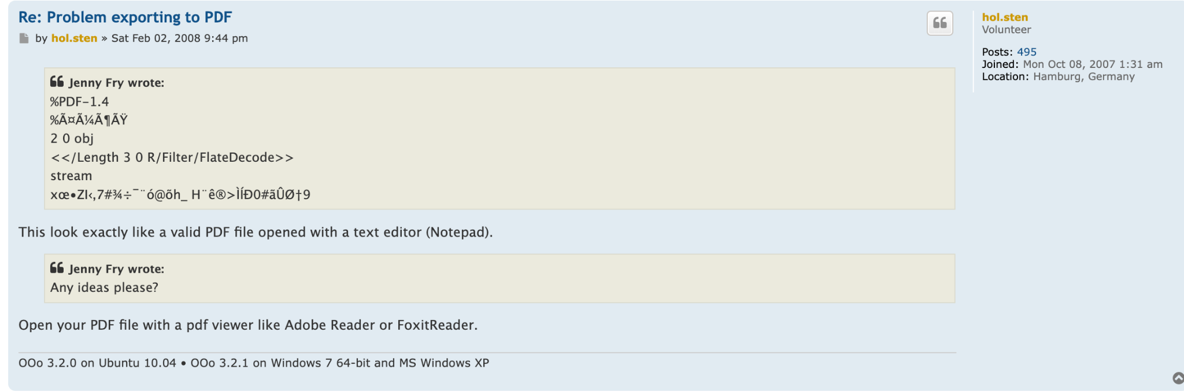
Thank you, hol.sten

Slide 15
What's Next?
Basically finish user story requirements!
Quality of life improvements
Add try catches
Uploading a PDF
Make sure current “edit profile” data can be viewed by user(s) - not just editing fields
Adding Date/Time aspects where needed
Allow Finance Manager, Claim Manager, and Admin to view user details
Allow Validation and Transfer where needed
For Sprint #5…

